Slide 1
BITS ZG553: Real Time Systems L14 – Performance Analysis
K G Krishna
WILP Division, BITS-Pilani, Hyderabad

Slide 2

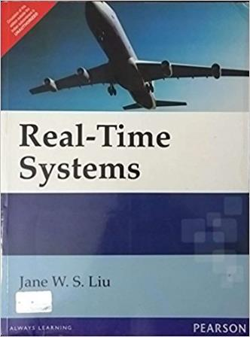
Text Book / References
Reference (R1)
Text Book (T1)
Note: As the above two books focus on theoretical treatment of the subject, Students are strongly advised to refer to web sources / MOOCs videos / library within their own organizations for more practical understanding of the topics.

Slide 3
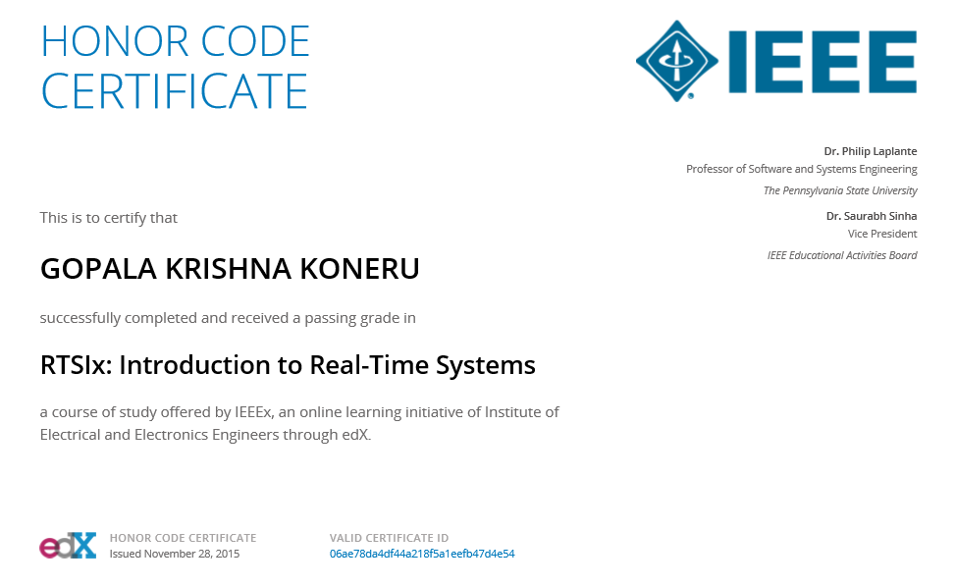
Excellent MOOCs Videos
(Coursera, edX,…)

Slide 4
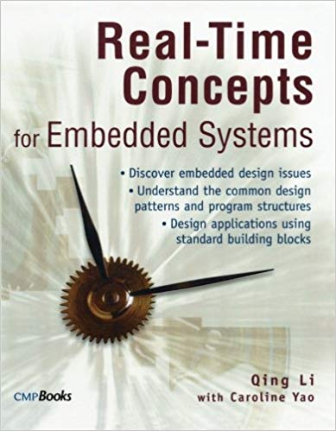
RTS Primer – For Light Reading

Slide 5
L-14: Performance Analysis of RTS
[Ref: Notes/PPT]
Note: Students are requested to NOT to rely on PPTs/Recorded sessions as their only source of knowledge, explore sources within your own organization or web for any specific topic; attend classes regularly and involve in discussions;
PLEASE DO NOT PRINT PPTs, Save the Environment!
Source PPT Courtesy: Some of the contents of this PPT is sourced from Presentatoons of Prof K R Anupa / Prof B Mishra, BITS-Pilani WILP Division

Slide 6
Introduction
Performance analysis activities occurs in all phases of development.
In testing phase, it is practical to measure performance in a real working environment.
But there are needs to analyze the performance at design phase itself.
Such performance measures are usually predicted and estimated.
It requires theoretical performance analysis techniques.

Slide 7
Theoretical Preliminaries
The complexity class P is the class of problems which can be solved by an algorithm which runs in polynomial time on a deterministic machine.
The complexity class NP is the class of all problems that cannot be solved in polynomial time by a deterministic machine. A candidate solution can be verified to be correct by a polynomial time algorithm.
A decision problem is NP complete if it is in the class NP and all other problems in NP are polynomial transformable to it.
A problem is NP-hard if all problems in NP are polynomial transformable to that problem, but it is impossible to show that the problem is in the class NP.

Slide 8
Challenges in analyzing real-time systems
When there are mutual exclusion constraints, it is impossible to find a totally on-line optimal runtime scheduler.
The problem of deciding whether it is possible to schedule set of periodic processes that use semaphores only to enforce mutual exclusion is NP-hard.
The multiprocessor scheduling problem
with two processors, no resources, independent tasks, and arbitrary computation times is NP-complete.
with two processors, no resources, independent tasks, arbitrary partial order and task computation times of either 1 or 2 units of time is NP-complete.
with two processors, one resource, a forest partial order (partial order on each processor), and each computation time of every task equal to 1 is NP-complete.
with three or more processors, one resource, all independent tasks and each computation time of every task equal to 1 is NP-complete.

Slide 9
Execution Time Estimation
Estimation of the execution time e_{i} is the most important task in modeling.
The most accurate method is using ‘Logic Analyzer’. But it can be done, when physical system is ready i.e. at the time of testing and characterization.
When the whole system is not ready, the execution time can be estimated by examining the compiler output, either manually or through a tool.
Another possible method is to use system timer
Note the system time before start of the execution.
Note the system time after end of the execution.
The difference in the time is the execution time.
Do this exercise for all possible code execution path and take the worst case time.

Slide 10
Analysis of round-robin systems
Assume
Number of tasks in the system = n
Time slice (time quantum) = q
Maximum execution time of each task T_{i} = c_{i}
Maximum execution time of all tasks c = max(c₁ , c₂ ,…, c_{n})
Then amount of time each task has to wait in one round = (n-1)q
Maximum number of time slices each task require to complete =
Then amount of time (worst case) each task has to wait in total =
The worst case time for a task to complete from readiness to completion
If there is a context-switching overhead of ‘o’, then for switching ‘n’ tasks in a cycle, the context switching overhead will be ‘n.o’.
In that case, the worst case time for a task to complete from readiness to completion

Slide 11
Round Robin System - Example
In a round-robin system, there are 6 equally important tasks, each with a maximum execution time of 600 ms and the time quantum is 40 ms, and every context switch costs 2 ms, then find out the response time of each task.
Solution:
Here, n = 6, q = 40 ms, c = 600 ms, o = 2 ms.
So,

Slide 12
Fixed Priority System
From time-demand analysis, the worst case response time is given by
But due to the ceiling function, this equation can’t be solved in a straight forward method. So let us do it in iterative method. We can rewrite this equation as,
where ‘n’ is the number of iteration.
Start the recursion with t₀ = e_{i}. The recursion stops, when t_{n+1} = t_{n}
If the recursion doesn’t converge, then the processor is overloaded.

Slide 13
Fixed Priority System - Example
Find out the worst case response times of the tasks T1 = (9, 3), T2= (12, 4) and T3 = (18, 2), when they are scheduled rate-monotonically.
Solution:
As per RM algorithm, the priorities of the tasks are: T1 > T2 > T3.
First check the total utilization.
Total utilization U = 3/9 + 4/12 + 2/18 = 0.72 <1.
Hence processor is not overloaded.
Since T1 is the highest priority task, its response time is equal to its execution time i.e. 3.

Slide 14
Fixed Priority System - Example
For T2,
So for T2, worst case response time is 7.
For T3,
So for T3, worst case response time is 9.

Slide 15
Analysis of Non-periodic Systems
A real-time system having one or more aperiodic or sporadic job can be modeled (as covered in the previous lectures)
But practically, they can be modeled rate monotonically as having periods equal to worst case inter-arrival times.
Such rough approximation leads to unacceptably high utilization.
So some heuristic approach should be used in stead.
Queuing theory could also be helpful.

Slide 16
Sources of indeterministic behaviour
Interrupt Latency
DMA
Caches
Instruction Pipelines
Floating point instructions
All of the above are to improve the CPU performance, but they destroys the determinism. This leads to go for a probabilistic performance model.

Slide 17
Single Server Queue Model
Server
Consumers
…
Served
Queue
Known as M/M/1 Queue
First M: Probability distribution of the time arrival of consumers : Here interrupt requests
Second M: Probability distribution of the time needed to service each customer: Here interrupt servicing
Third 1: Number of servers
The probability distribution of arrival is Poisson Distribution (inter-arrival times are exponentially distributed)
The service or processing time is also exponentially distributed.

Slide 18
Single Server Queue Model
Let
1/λ = Mean inter-arrival time of the customers (interrupt requests)
1/μ = Mean service (or interrupt processing ) time
1/λ > 1/μ
N = Number of customers (interrupt requests) in the queue
Then, the expected number (mean) of customers (interrupt requests or jobs) in the queue,
The corresponding variance,

Slide 19
Single Server Queue Model
The mean time a customer (job) spends in the system,
If Y is a random variable for the time spent in the system, which has an exponential probability distribution,
Probability that at least k customers (jobs) are in the queue simultaneously,
When there are more than one customer waiting in the system, it is a time-overloaded condition. From this equation, it is obvious that the probability of exceeding a certain number of customers (jobs) in the system decreases geometrically (since ρ≤1). So it is pointless to determine the probability when there are more then two customer in the systems, since it will be negligible. Hence for determining the probability of time overloading, it is sufficient to consider the probability of two customers (jobs) in the system i.e. Pr[≥2].

Slide 20
Example 1
In an interrupt driven system, the mean processing time of the interrupt is 5 ms. What should be the mean inter-arrival time of the interrupts, so that there is a 98% confident that CPU will not be overloaded?
Solution:
Mean interrupt processing time, 1/μ = 5 ms.
Probability of overload = 100% - 98% = 2%
Hence mean interrupt inter-arrival time should be more than 35.46 ms.

Slide 21
Example 2
In an interrupt driven system, the mean inter-arrival time of the interrupt is 10 ms. What should be the mean processing time of each interrupt, so that there is a 98% confident that CPU will not be overloaded?
Solution:
Mean inter-arrival time, 1/λ = 10 ms.
Probability of overload = 100% - 98% = 2%
Hence mean interrupt processing time should be less than 1.41 ms.

Slide 22
Example 3
A producer task is known to process data at rate that is exponentially distributed with average service time of 3 ms per task. What is the maximum allowable average data rate if the probability of collision is to be no more than 1%. Assume that the data arrive at intervals that are exponentially distributed.
Solution:
Mean task processing time, 1/μ = 3 ms.
Probability of collision(overload) = 1%
Hence maximum allowable data rate = 1 / (30 ms) = 1000 / 30 per sec = 33.33 per sec.

Slide 23
Example 4
In an interrupt driven system, the mean inter-arrival time of the interrupt is 5 ms and mean interrupt processing time is 3 ms. What should be the mean response time of each interrupt ? What should be the mean and variance of the buffer required to store the incoming interrupt requests ?
Solution:
Mean inter-arrival time, 1/λ = 5 ms.
Mean interrupt processing time, 1/μ = 3 ms.
Average response time,
Average length of the buffer required to store the interrupt requests,
Variance of the buffer length,

Slide 24
Analysis of Memory Requirements
A typical memory map constitutes
Program
Stack
Data
Parameters
Total Memory Utilization,
Here M_{PG}, M_{ST}, M_{DT}, M_{PM} represents memory utilization of program memory, stack memory, data memory and parameter memory respectively. Similarly P_{PG}, P_{ST,} P_{DT}, P_{PM} represents the fraction of the total memory used for these types of memories respectively.

Slide 25
Example - Memory Requirements
A system has 64 M bytes of program memory, 16 M bytes of data memory and 8 M bytes of stack area. A program requires 75% of program memory, 25% of data memory and 50% of stack area, which are the worst case scenario. The system doesn’t have separate parameter memory area. Calculate the memory utilization of the program.
Solution:
Total Memory = 64 + 16 + 8 M bytes = 88 M bytes
Total memory utilization,

Slide 26
Thank You.
Any Questions?

